Slide 1
Objectives:
1-Types of inhibitors
1-To study the factors regulating enzyme activity:
A. Changes in enzyme quantity
. Allosteric inhibition
B. Feedback inhibition
C. Zymogens
D. The effect of hormones
E. Covalent modification
2-To study isoenzymes
To illustrate creatine kinase isoenzymes. -3

Slide 2
5.Activators & inhibitors:
Activators : substances which increases enzyme activity
Ex: Cl⁻ act as activator of salivary amylase .
Inhibitors: substances which reduces or abolishes enzyme activity.

Slide 3
EFFECT OF INHIBITORS
Any substance that can reduce the velocity of an enzyme catalyzed reaction is called an inhibitor and the process is known as inhibition.
In general, irreversible inhibitors bind to enzymes through covalent bonds.
Reversible inhibitors typically bind to enzymes through noncovalent bonds.

Slide 4
Types of inhibition
May be reversible or irreversible
1- reversible the inhibitor combine rapidly & reversibly with enzyme or enzyme substrate
Have three major types
1-Competitive
2-non competitive
3-uncompetitive

Slide 5
Competitive inhibitor
The inhibitor can combine with the free enzyme in away that it compete with the normal substrate for binding at the active site
A competitive inhibitor must reacts reversibly with enzyme to form enzyme – inhibitor complex
Inhibitor molecule is not chemically change by the enzyme .
Example: Malonate that competes with succinate and inhibits the action of
succinate dehydrogenase to produce fumarate in the Krebs cycle.

Slide 6
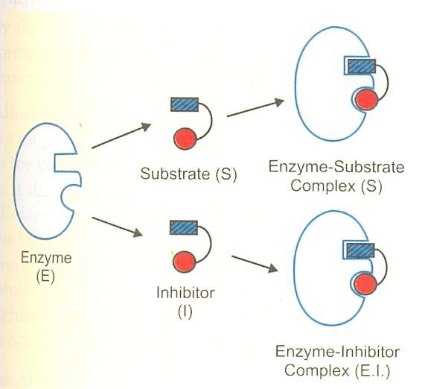

Slide 7
Effect of Competitive inhibitors:
Effect on Vmax: The effect of a competitive inhibitor is reversed by increasing at a sufficiently high substrate concentration; the reaction velocity reaches the Vmax observed in the absence of inhibitor. This means that the effect remains same.
Effect on Km: A competitive inhibitor increases the apparent Km for a given substrate. This means that in the presence of a competitive inhibitor more substrate is needed to achieve ½ Vmax.

Slide 8
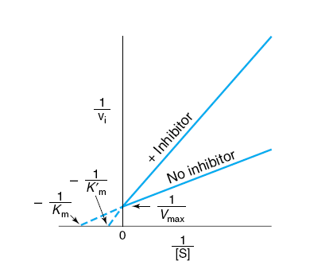
Lineweaver – Burk plot of Competitive inhibition Where: 1. Vmax: not changed 2. Km: increased

Slide 9
2. Non – competitive inhibition :-
In non-competitive inhibition the inhibitor binds at different site rather than the substrate-binding site.
when the inhibitor binds at this site there will be a change in conformation of the enzyme molecules, which leads to the reversible inactivation of the catalytic site.
Non-competitive inhibitors bind reversibly either to the free-enzyme or the ES complex to form the inactive complexes.

Slide 10
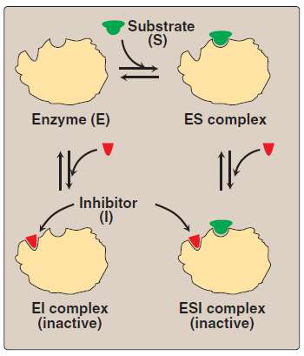

Slide 11
An Example:
The inhibition of L-threonine dehydratase by L-isoleucine.
Such type of enzyme is called Allosteric Enzyme, which has a specific sites or allosteric site other than the substrate-binding site.

Slide 12
Effect of Non - Competitive inhibitors
Effect on Vmax: Non-Competitive inhibition cannot be overcome by increasing the concentration of substrate. Thus, non-competitive inhibitors
decrease the Vmas of the reaction
Effect on Km: Non-competitive inhibitors do not interfere with the binding of substrate to enzyme. Thus, the enzyme shows the same Km in the presence or absence of the noncompetitive inhibitor.

Slide 13
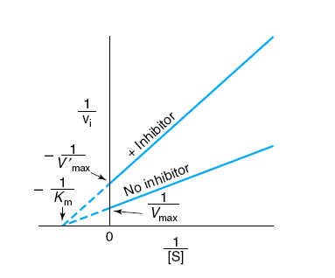
Lineweaver – Burk plot of Non-competitive inhibition Where: 1. Vmax: decreased 2. Km: not changed

Slide 14
3-UN COMPETITIVE INHIBITION
Uncompetitive Inhibitor binds only to ES
complex at locations other than the catalytic site.
Substrate binding modifies enzyme structure, making inhibitor-binding site available.
Inhibition cannot be reversed by substrate. In this case apparent Vmax and Km decreased.

Slide 15
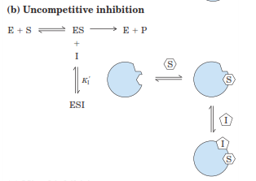

Slide 16
Irreversible inhibition :
The effect of the inhibitor cannot be removed and enzyme activity cannot be regained. Enzymes undergo irreversible inhibition when treated with agents capable of covalently and permanently modifying a functional group essential for the catalytic activity of the enzyme.
Example: Inhibition of triose phosphate dehydrogenate by iodo acetate which block the activity of the enzyme.

Slide 17
Regulation of Enzyme Activity
1-regulation of enzyme quantity:
The amount of enzyme may be increased by increasing the rate of synthesis. Decreased by decreasing the rate of degradation.
A- Regulation by induction
Induction of synthesis of a particular enzyme.
The effector is called inducer (substrate, Hormone).
B-Regulation by repression:
Number of enzyme molecules decreased by repression. The effector is called repressor.

Slide 18
2- Allosteric Regulation
Allosteric Enzymes are regulated by molecules called allosteric effectors (also modifiers) that bind noncovalently at a site ( allosteric site ) other than the active site.
These enzymes are composed of multiple subunits, and the regulatory site that binds the effector may be located on a subunit that is not itself catalytic.

Slide 19
The presence of an allosteric effector can alter the affinity of the enzyme for its substrate, or modify the maximal catalytic activity of the enzyme, or both.
Effectors that inhibit enzyme activity are termed negative effectors, whereas those that increase enzyme activity are called positive effectors.

Slide 20
Allosteric effectors could be:
1. Homotropic effectors: When the substrate itself serves as an allosteric effector, the effect is said to be homotropic. Most often, an allosteric substrate functions as a positive effector.
2. Heterotropic effectors: The allosteric effector may be different from the substrate. Heterotropic effectors are commonly encountered,for example, the glycolytic enzyme phosphfructokinase allosterically inhibited by citrate, which is not a substrate for the enzyme

Slide 21
MODEL OF ALLOSTERIC REGULATION
Two main model have been proposed to describe the mechnastic basis of enzyme allostery:
1-Concerted model :
2-Sequential model:

Slide 22
Concerted ( Symmetry ) Model
For an enzyme consists of 2 identical subunits each with one active site. The subunits present in 2 conformations either T ( low affinity ) or R ( high affinity ).
An important assumption of the concerted model is that both subunits must be in the same conformational state: the binding of the first substrate molecule to one subunit increases the tendency of all subunits to undergo transition to the high affinity form through an all- or non – effect.
All subunits being either in the low affinity or high affinity forms. Therefore , in the concerted model, TT , RR conformations are allowed , but TR conformation is not permitted.

Slide 24
2. Sequential Model
It postulates that the subunits undergo individual sequential changes in conformation. The binding of the S molecule change the shape of the subunit to which is bound, However, the conformational state of the other subunit is not necessarily altered. Thus, TR conformation is allowed in addition to TT and RR conformations.

Slide 26
3-Feedback inhibition:
The end product of metabolic pathway results in allosteric inhibition of the first enzyme in the pathway.
Example :
For a biosynthetic pathway from A to D
Enz 1 Enz 2 Enz 3
A B C D
High concentration of D typically inhibit Enzyme 1

Slide 27
4-Zymogens ( Proenzymes) :
Are enzymes which are synthesized initially in an inactive form, and then activated at physiologically appropriate time and place.
The classical examples are the digestive enzymes: Pepsin , Trypsin and Chymotrypsin which are secreted in an inactive forms .
Modes of activation :- Could be
Exocatalysis :
when a zymogen is activated by another substance.
Autocatalysis:
when a zymogen is activated by it's already activated precursors.

Slide 28
Examples:
1) HCL “ exocatalysis”
Pepsinogen pepsin
2) Pepsin “ autocatalysis”
1) Enterokinase “ exocatalysis”
Trypsinogen Trypsin
2) Trypsin “ exocatalysis”
Trypsin “ exocatalysis”
Chymotrypsinogen Chymotrypsin

Slide 29
5-Covalent Modification :-
This is done by reversible covalent insertion of a small group ( ex. phosphate) on certain amino acid residue of an enzyme ( ex. serine, threonine, tyrosine, histidine) resulting in modulation of their activity.
Enzymes undergo covalent modification are called Interconvertable enzymes existing in 2 states of activity:
one of high catalytic activity and the
other of low catalytic activity.

Slide 30
ISOENZYMES
Definition:
- The multiple forms of an enzyme catalyzing the same reaction are isoenzymes .
-Isoenzymes may be present in different tissues of the same organism, in different cell types or subcellular compartments.
Besides the source, they also differ from each other with respect to their structure, electrophoretic mobility and immunological properties.

Slide 31
Lactate dehydrogenase (LDH) :
There are 5 isozymes of LDH ( 1- 5 ), separated by electrophoresis, all catalyses the same reaction:
LDH
Lactate + NAD⁺ pyruvate + NADH + H⁺
Each isozyme consists of 4 polypeptide chains: H and/or M

Slide 32
LDH ISOZYMES
Isozyme No. Subunits Organ Clinical Significance
1 HHHH Heart Myocardial Infarction
2 HHHM Heart, Kidney RBCs Myocardial Infarction
Renal cortex infarction, Haemolytic anaemia,
3 HHMM Widely distributed Little significance
4 HMMM Widely distributed Little significance
5 MMMM Liver, skeletal muscle Acute hepatitis, Acute muscle injury,
Muscle diseases

Slide 33
Creatine Phosphokinase (CPK)
( Creatine Kinase) ( CK)
There are 3 CK isozymes ( CPK 1 – 3 ) separated by electrophoresis, all catalyzes the same reaction:-
CPK
Creatine + ATP phosphocreatine + ADP
Mg²⁺
Each isozyme consists of 2 polypeptide chains : B and/or M

Slide 34
CPK ISOZYMES
Isozyme No. Subunits Organ Clinical Significance
1 BB Brain Brain disease, Severe shock
2 MB Heart Myocardial Infarction
3 MM Skeletal muscle Acute muscle injury, Muscle disease,

